Slide 1
LKS2 Mathematics Parents’ Workshop – Year 3/4

Slide 2
Aims of today
To get an insight into how Maths is taught in year 3 / 4 (add, subtract, multiply and divide.
To understand mastery and what this means in the classroom.
Be familiar with the times table check that your child will sit either this year or next year.
To work with your child and take part in a variety of Maths activities.
To take away some ideas to support your children at home.

Slide 3
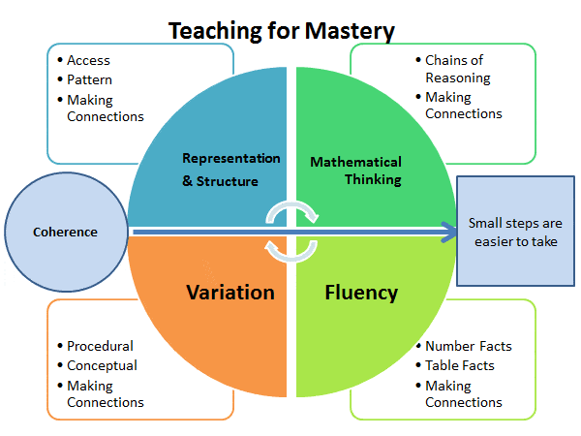

Slide 4
We assume that everyone can learn and enjoy mathematics.
Their learning behaviours are developed such that pupils focus and engage fully as learners who reason and seek to make connections.
Lesson design links to prior learning and progresses in careful steps to build understanding.
Practice and revisiting previous learning is a vital part of our maths lessons.

Slide 5
MTC (Multiplication Tables Check) – Every child in the country takes the test.
By the end of Year 4, children should know all their times tables and division facts up to 12 X 12.
It tells us how many the children know and how we can support them going ahead.
Whether multiplying or dividing, adding or subtracting, we want children to be able to do as much in their head as possible without counting on fingers!
https://www.timestables.co.uk/multiplication-tables-check/

Slide 6
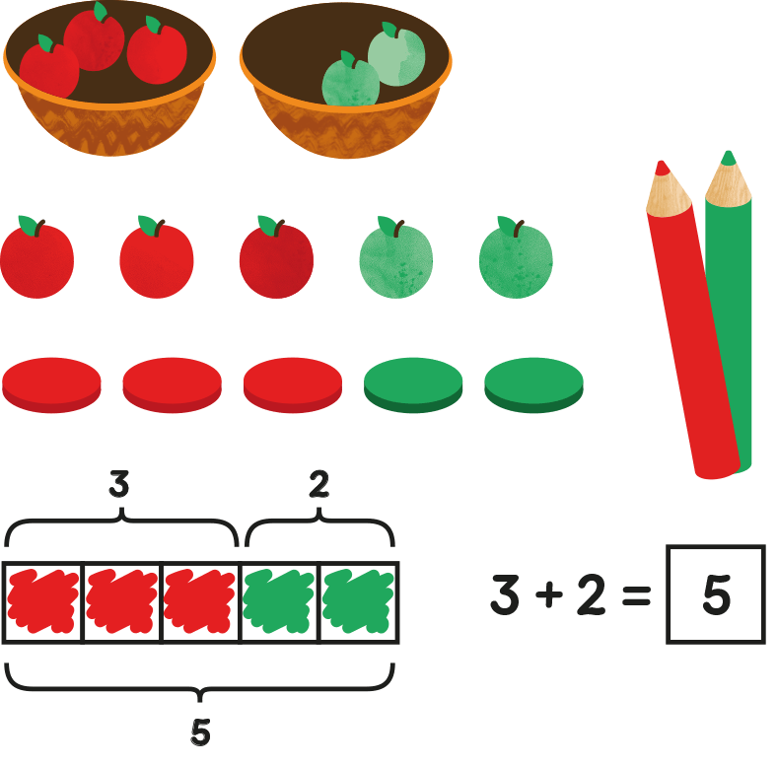
Stages of teaching: Concrete – Pictorial - Abstract
With the foundations firmly laid, students should be able to move to an abstract approach using numbers and key concepts with confidence. This is how we can make children fluent in maths.

Slide 7
Addition in Year 3
Eva has £105
Sam has £87
How much money do they have in total?
£192
 | H | T | O
 | 1 | 0 | 5
 |  | 8 | 7
£105
£87
1
9
2
1

Slide 8
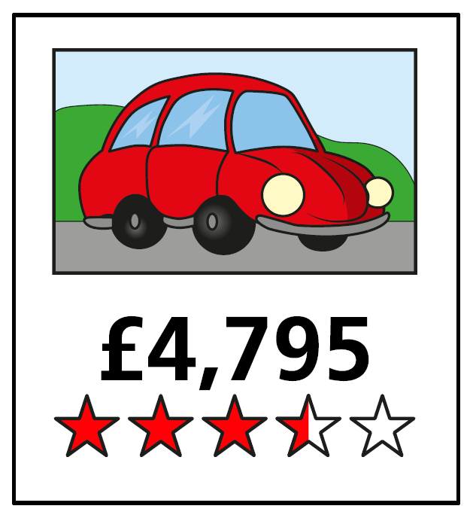
Addition in Year 4
Two cars are for sale.
The first car costs £4,795
The second car costs £155 more.
1) How much does the second car cost?
2) Mr Li has £9,500
He wants to buy both cars.
Does he have enough money?
£4,950
 | 4 | 7 | 9 | 5
 | 4 | 9 | 5 | 0
 | 4 | 7 | 9 | 5
 |  | 1 | 5 | 5
No
The two cars total £9,745
9
7
4
5
4
9
5
0
1
1
1
1

Slide 9
Subtraction Year 3
325
Hundreds | Tens | Ones
 | H | T | O
 | 3 | 5 | 1
4
1
2
6
3
2
5
3
2
5
I put 2 in the _____ column because it has a value of _____
ones
tens
I put 6 in the _____ column because it has a value of _____
20
6

Slide 10
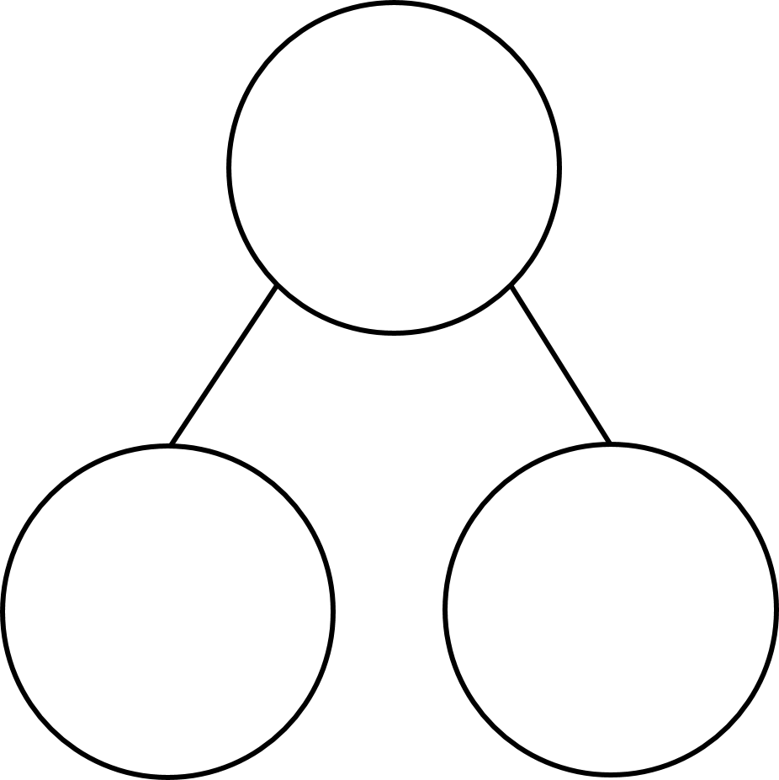
Multiplication Year 3
What multiplication is shown by the counters?
Tens | Ones
30
2
10

Slide 11
Multiplication Year 4
Pencils come in packs of 25
Each class in the school gets 6 packs.
There are 6 classes in the school.
How many pencils are there altogether in the school?
25
900
T O
H T O
1
2
5
5
0
6
6
1
5
0
9
0
0
1
3
3
Have a think

Slide 12
Division Year 3
51 ÷ 3 =
17
96 ÷ 4 =
24
51
96
96
1
30
21
16
50
11
80
40
÷ 3
÷ 3
÷ 4
÷ 4
10
7
20
4
10 + 7 =
17
24
20 + 4 =
24

Slide 13
Division Year 4
115 ÷ 5 =
23
H | T | O
115
100
15
÷ 5
÷ 5
20
3

Slide 14
Any questions before we go in to classes?

Slide 15
Next steps
Is there anything extra that you would like support with?
When we run sessions next academic year, what would you like to see?

Slide 16
How you can help at home?
Number bonds to 20 and the related facts (16 + 4 = 20 so 160 + 40 = 200)
Telling the time.
To use maths in a real life context.
Cooking.
Shopping
Practise times tables
TTRS

